Slide 1
Positive Behavior Supports

Slide 2
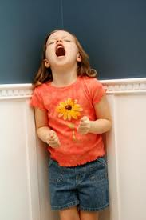
Behavior – What is It?

Slide 3
A way of getting something or someone to someplace.
A way of getting away from something, someone, or someplace.
Both

Slide 4
ABC Model
Antecedent – A stimulus or trigger. Things we want or want to get away from.
Behavior – A response to the antecedent. We use behavior to accomplish our goals.
Consequence – Let’s people know how effective or ineffective their behavior was in achieving their goal. Gives feedback about how we did or did not accomplish our goals.

Slide 5
Consequences
Students need more than just a consequence.
They need to learn how to change their behavior for next time.
Changing the antecedent is the most effective way to support people.

Slide 6
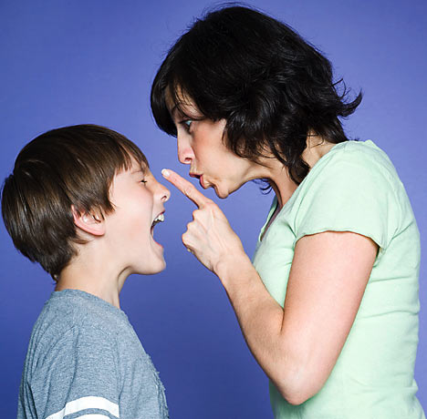
Power Struggles

Slide 7
Power Struggles
We get into power struggles with our students, because we are not on the same page as our students.
We need to get to know our kids. (Background, home life, etc.)
We need to take time to listen to them.
What setting events took place at home or on the bus?
There is a reason behind these challenging behaviors

Slide 8
Ways to reduce challenging behaviors and prevent power struggles
Listen to your students – Don’t jump to conclusions
Respond calmly – Take a few minutes to get under control
Teach alternate behaviors
Offer choices – Eliminate a potential power struggle
Notice the positives in your students (stay positive)
Be consistent
  1. Students evaluate us all the time
  2. Let your students know of changes to your schedule

Slide 9
Ways to reduce challenging behaviors and prevent power struggles cont.
Have Fun
Don’t take the Bait

Slide 10
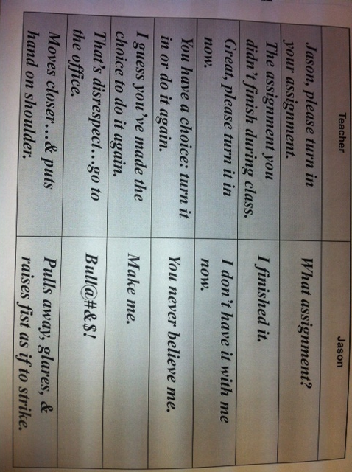
Power Struggle Example

Slide 11

Positive Behavior Support

Slide 12
Positive Behavior Supports
Definition
To gain knowledge about how to better understand people and help them make changes in their lives to reduce challenging behaviors and reinforce positive behaviors.
Take time to set up interventions to help people use their strengths to meet their own needs.
Let students think – Too often we make decision for them.
Do we like being told what to do? We want to have input.
Think Prevention

Slide 13
Prevention
Prevention strategies reduce the likelihood that the child will need or want to use the challenging behavior.

Slide 14
Prevention questions to ask yourself
How can my environment be changed to reduce the likelihood that the behavior will occur?
How can I build on what works?
What can be done to help the child deal with or avoid behavior triggers?

Slide 15
Reinforcement vs. Punishment
Reinforcement
The purpose of reinforcement is to increase the likelihood of that behavior.
Studies show that reinforcement is more effective at changing behaviors than punishment.
Take time and let them know exactly what they did well.

Slide 16

Reinforcement

Slide 17
Punishment
We punish to decrease behavior.
Is punishment always effective?
When we punish we usually take something away!

Slide 18

Punishment

Slide 19
Consider this
“If a child doesn’t know how to read, we teach.”
“If a child doesn’t know how to swim, we teach.”
“If a child doesn’t know how to multiply, we teach.”
“If a child doesn’t know how to spell, we teach.”

Slide 20
Consider this cont.
“If a child doesn’t know how to behave –
  We teach?
  We punish?

Slide 21
Bottom Line
Treat People with Dignity and Respect
Know the students we are serving
- Setting Events
- Triggers
- De-escalation strategies
- Behavior Plans (Work with SIT team)
Build a rapport with your students
BE NICE

Slide 22
Video
http://youtu.be/4RDncxuhQsg

